Slide 1
User Feedbacks in Backlog - the good & bad
Tuula Pääkkönen
Information Systems Specialist
This work is licensed under a Creative Commons Attribution 4.0 International License.

Slide 2

The Users
Hey,
Why?
How do I…
Could I…
I can’t…
This doesn’t …
I like/I don’t like…
Image source: pixabay.com

Slide 3
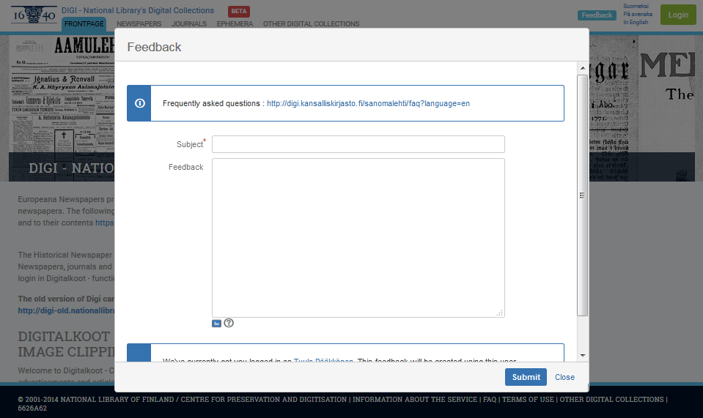

Slide 4
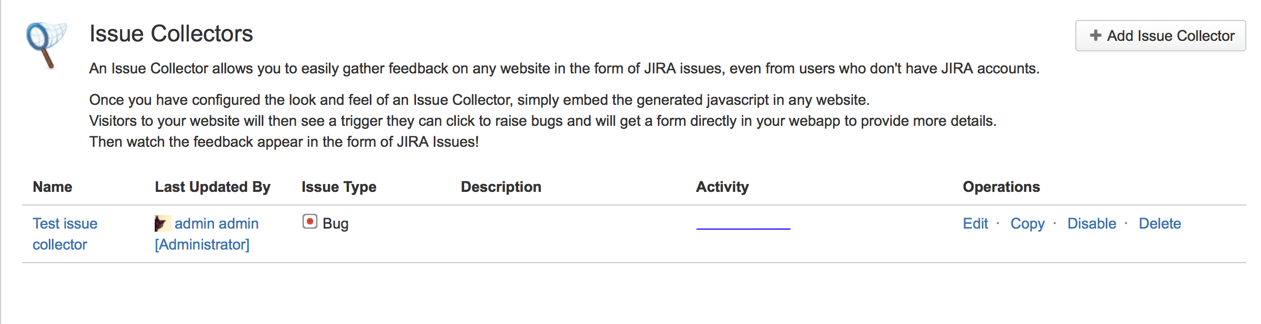
The Issue Collector – how does it work?
Issue collector can act as feedback form
Create Issue collector in Jira & Customize if needed
Add html/javascript code to website
After user sudmits form it goes to the backlog DIRECTLY
Image source: https://confluence.atlassian.com/jira/using-the-issue-collector-288657654.html

Slide 5
The Cold (-)
“Bit too fast answers to the queries” & “missed feedbacks”
“User feedback” vs. “feedback feedback”
– only 1 feedback type configured
Only 3 fields asked from user (subject*, description*, email)
Email is skipped, and still looks like person wants answer
Part of the list of the backlog
Who responses?

Slide 6
The Hot (+)
Everything in one tool
Feedbacks act as good “pulse” of the users
Great source for discussion
Stores the responses => mini-knowledge base

Slide 7
Takeaways
Backlog prioritization
User feedback => prioritization impact
All-in-one or custom tool
“Thank you, I’ve added it to backlog”
Well actually, the user has added it to backlog themselves ☺

Slide 8
Thank you

